Slide 1

The 3-Track Workforce Enablement & Change Adoption Suite
A structured, competency-building engine embedded directly into the transformation engagement to accelerate AI fluency, eliminate displacement fears, and deliver permanent operational ROI for Novatech.
Client Partner Novatech Leadership & Teams
Engagement Partner Nisol AI Transformation Advisory
Commercial Model 100% Included in Core Professional Fees
Curriculum Depth 3 Synchronized Tracks (All-Hands to Board)

Slide 2

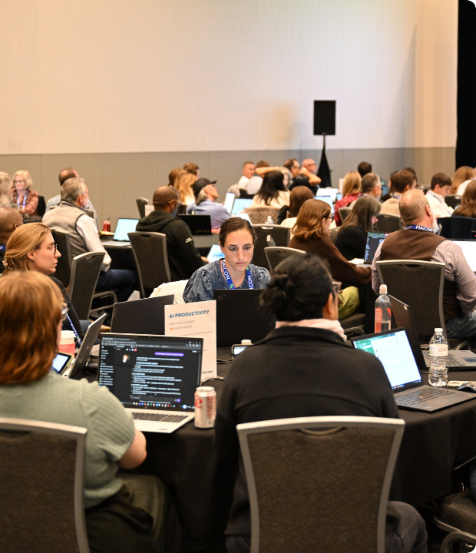
Adoption & Enablement Philosophy
Competency-Building Engine
Technology transformations fail when change management is treated as an afterthought. Nisol AI rejects passive slide webinars in favor of hands-on, contextualized literacy.
Our 3-Track Curriculum runs parallel to technology deployment waves, addressing psychological friction, cultivating super-users, and empowering executive governance simultaneously.

Slide 3






The 3-Track Enablement Architecture
AI Readiness & Demystification
The New Way of Working
Leading AI Teams & Governance
Target: All Novatech Employees (Company-wide)
Target: 40–50 Department Champions across Functions
Target: Executives, CTO, CFO, CMO, VP Sales, VPs
•
2 x 90-minute live interactive all-hands sessions
•
4 x 2-hour hands-on sandbox labs (capped at 15/cohort)
•
1 x Half-day in-person or virtual leadership seminar
•
Core AI demystification & function-specific impacts
•
Function-specific prompt engineering & workflows
•
Workforce reallocation: "Manual doers" to "Supervisors"
•
Responsible AI, ethics, and hallucination awareness
•
Enterprise RAG knowledge hub integration
•
Managing grief cycles and cultural resistance
•
Transparent Q&A addressing displacement fears
•
Human-in-the-loop validation & fallback protocols
•
Model governance dashboards & Wave ROI tracking

Slide 4


Track 1: AI Readiness & Demystification
Broad Literacy & Psychological Safety
Direct Answers & Measurable Lift
Designed for 100% of Novatech personnel across Engineering, Sales, Finance, Operations, and Customer Support to establish a common enterprise baseline.
Directly tackles the critical question: "Will AI replace my job?" with total transparency regarding workflow evolution.
•
Responsible AI: Ethics, security parameters, and hallucinations.
•
Format: 2 x 90-minute all-hands virtual live sessions.
•
Workflow Impact: Department-specific use case exposure.
•
Flexibility: Recorded with interactive transcripts for on-demand access.
•
Measurable Outcome: Baseline enterprise AI awareness increases from 0 → 60% in 3 instructional hours.
•
Hands-on: Practical primer on structured prompt drafting.

Slide 5


Track 2: The New Way of Working
Building Department Super-Users
Focused on 40–50 selected Subject Matter Experts (SMEs) across Sales, Finance, Ops, and Engineering to build self-sustaining internal champions.
•
Lab Structure: 4 x 2-hour intensive sandbox labs capped at 15 attendees for deep personalization.
•
Applied Prompting: Department workflows (e.g., automated RFP generation, invoice data extraction).
•
Human-in-the-Loop: Precise frameworks for when to trust AI outputs vs. when to intervene and override.
•
Enterprise RAG: Real-time querying across internal policies and historical knowledge bases.
•
Outcome: Super-users reach operational mastery in 8 hours and act as frontline peer mentors.

Slide 6


Track 3: Leading AI Teams & Governance
Strategic Workforce Reallocation
Model Oversight & Direct ROI Ownership
A dedicated half-day seminar facilitated by a Nisol AI Senior Partner for the C-Suite and Department Heads (CTO, CFO, CMO, VP Sales).
Equips business unit leaders to own the business outcomes, risk controls, and financial returns of the AI transformation.
•
Role Elevation: Transitioning direct reports from "manual task executioners" to strategic "AI supervisors."
•
Health Dashboards: Interpreting drift, latency, hallucination rates, and intervention triggers.
•
Performance Metrology: Redefining KPIs and performance management for AI-augmented teams.
•
Wave ROI Tracking: Quantifying hours saved, cycle-time reductions, and revenue impact.
•
Change Psychology: Actively guiding teams through grief cycles and change friction.
•
Measurable Outcome: Leaders gain sovereign governance capability—owning ROI, not just software licenses.

Slide 7

Comprehensive 3-Track Curriculum Matrix
Track Name | Target Audience | Format & Duration | Core Curriculum Modules | Measurable Exit Metric
Track 1: Readiness & Demystification | All Employees (Company-wide across all depts) | 2 x 90-min Live Virtual Sessions (Recorded on-demand) | GenAI fundamentals, ethics, hallucination guards, job security Q&A | Awareness: 0 → 60% within 3 total hours
Track 2: The New Way of Working | 40–50 Department Super-Users & Champions | 4 x 2-hr Hands-on Sandbox Labs (Cap: 15/cohort) | Applied prompt workflows, RAG hub search, human-in-the-loop protocols | Full Proficiency in 8 hours; active peer mentoring
Track 3: Leading AI Teams | C-Suite, VPs & Heads (CTO, CFO, CMO, Sales) | 1 x Half-Day Seminar (Nisol AI Partner-led) | Workforce reallocation, change friction, model dashboards, Wave ROI | 100% Governance & ROI ownership by business leaders

Slide 8



Measurable Adoption & Commercial Impact
60%
8 Hrs
$0
Baseline Literacy Lift
To Operational Mastery
Additional Add-on Cost
Company-wide AI comprehension shifts from zero to functional fluency in just two 90-minute sessions.
40–50 champions trained across 4 sandbox cohorts, creating decentralized peer support across Novatech.
Fully bundled into Nisol AI Professional Fees—curriculum, facilitators, and lab environments included.

Slide 9

Executive Governance & Culture Alignment
Navigating the Human Element of AI
The biggest hurdle in enterprise AI adoption is not technological capability—it is human inertia and anxiety over replacement.
•
Proactive Psychological Safety: We address displacement fears head-on with explicit career evolution pathways.
•
Supervisory Reorientation: Shifting team evaluation from keystrokes and volume to critical evaluation and editorial oversight.
•
Cross-Departmental Rhythms: Ensuring leadership synchronizes AI velocity between Engineering, Operations, and GTM teams.

Slide 10




Enablement Execution & Wave Timeline
Track 3 Kickoff
Track 1 All-Hands
Track 2 Sandbox Labs
Self-Sustaining Scale
Executive Leadership Seminar. Align C-Suite on governance, metrics, and workforce reallocation strategy.
Company-wide Session 1 & 2. Demystify GenAI, establish ethical guidelines, and alleviate displacement fears.
4 Weekly cohorts for 40-50 SMEs. Deep prompt engineering, RAG integration, and fallback protocols.
Super-users lead departmental peer mentoring. Continuous model health monitoring and Wave ROI realization.

Slide 11

Commercial Model & Partnership Roles
Included in Professional Fees
Client Commitments (Page 34)
Zero additional licensing or add-on service cost. Complete end-to-end enablement delivery provided by Nisol AI:
Critical operational prerequisites required from Novatech to ensure complete transformation success:
•
Expert Facilitators: Senior transformation leaders & AI engineers.
•
Calendar Holds: Protected time slots for Track 1, 2, and 3 cohorts.
•
Bespoke Curriculum: Tailored specifically to Novatech's stack and data.
•
SME Nomination: Designating 40–50 proactive champions across depts.
•
Interactive Labs: Secure sandbox environments with enterprise RAG access.
•
Executive Sponsorship: Active participation in Track 3 leadership governance.

Slide 12

Questions & Next Steps
Transforming Novatech into an AI-fluent enterprise through structured, measurable, and human-centered enablement.
Nisol AI Transformation Advisory
SME Dependency Checklist (Page 34)
Responsible AI Framework

Slide 13



Image Sources
https://smarterx.ai/hs-fs/hubfs/MAI_2664.jpg?width=4128&height=2752&name=MAI_2664.jpg
Source: smarterx.ai
https://ecisolutions.imgix.net/images/Blog/ai-in-erp-business-analytics-dashboard.jpg?auto=compress%2Cformat&crop=focalpoint&cs=tinysrgb&fit=crop&fp-x=0.5&fp-y=0.5&fp-z=1&h=642&q=90&w=1320&s=8f2ff87c783d4056f9ba18eeea2377bc
Source: www.ecisolutions.com
https://cloudsecuritycpd.com/cdn/shop/files/CloudSecurityForBusinessLeadersAndExecutives.jpg?v=1787238368&width=826
Source: cloudsecuritycpd.com

